Slide 1

OpenIPSL A Modelica Library for Power Systems Simulation
Assoc. Prof. Luigi Vanfretti
luigiv@kth.se,
https://www.kth.se/profile/luigiv/
Preparatory work – aka home work!
Please follow these slides before taking part in the Workshop/Tutorial/Seminar.
Notes:
Airport to central station
Take line 3 or line 4 to Nyl… (Stattnet)

Slide 2
Requirements
Requirements for the workshop are:
We have only tested our tutorial for the following configurations.
Windows:
PC with installed Windows 7 or later
Installation of OpenModelica
Mac:
OSX El Capitan
Installation of OpenModelica (binaries!)
Xcode (Version 8.0)

Slide 3

Getting Started with OpenModelica and OpenIPSL
This presentation is a 2-part guide containing the preparatory work needed to carry out the hands-on examples of the Modelica and OpenIPSL workshop/tutorial/seminar.
Part 1: Setting up
Part 2: Setting up OpenIPSL

Slide 4
Part 1
Setting up OpenModelica

Slide 5
Installation of
Instructions:
Download the installation package
Windows:
https://www.openmodelica.org/download/download-windows
1.9.6: https://build.openmodelica.org/omc/builds/windows/releases/1.9.6/OpenModelica-v1.9.6.exe
1.9.11:
https://build.openmodelica.org/omc/builds/windows/releases/1.11.0/
Mac:
1.9.6: https://build.openmodelica.org/omc/builds/mac/binaries/latest-release-1.9.6.mpkg
Launch the Installation package and follow the instructions with default options
Note!
Compatibilty with OpenIPSL is checked for OpenModelica versions 1.9.6 (Mac and Windows) and 1.9.11 (on Windows)

Slide 6
No MAC OSX or Windows OS – No Problem!
OpenModelica is available for GNU/Linux distributions here:
https://www.openmodelica.org/download/download-linux
Note: the compatibility of OpenIPSL has not been tested under these OS distributions
Virtual Machine:
OpenModelica can be installed through pre-built Virtual Machines containing all the libraries and clients that come with OpenModelica.
See instructions here:
https://www.openmodelica.org/download/virtual-machine
Note: the compatibility of OpenIPSL has not been tested under these VM configurations.

Slide 7
Check of OpenModelica
Tasks to check OpenModelica is correctly installed on your computer:
Start OpenModelica Connection Editor (OMEdit)
In the Libraries Browser navigate to Modelica.Blocks.Examples.PIDController
Select Runge Kutta as a solver and simulate the model
In the “Plotting” view, plot variable speedSensor.w

Slide 8
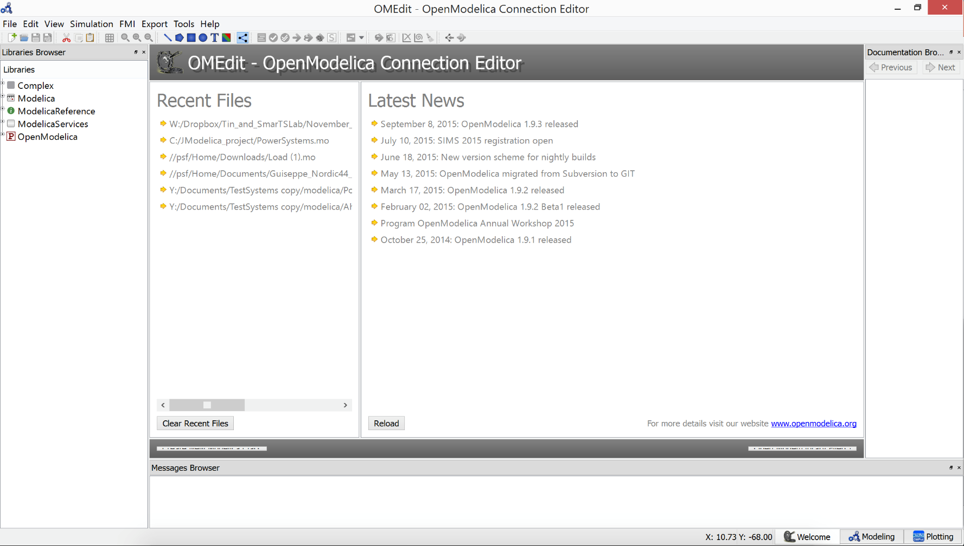
Check of OpenModelica – Step 1
Upon launch, the Connection Editor will present the following window

Slide 9
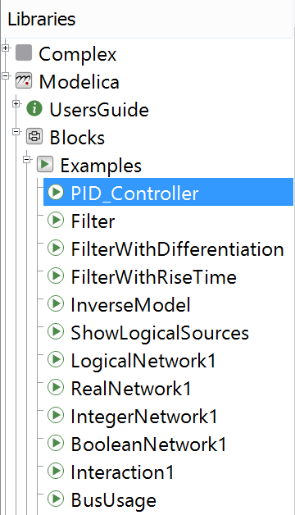
Check of OpenModelica – Step 2
Browse the Modelica library to find the PID_Controller and open it
Double-click to open

Slide 10

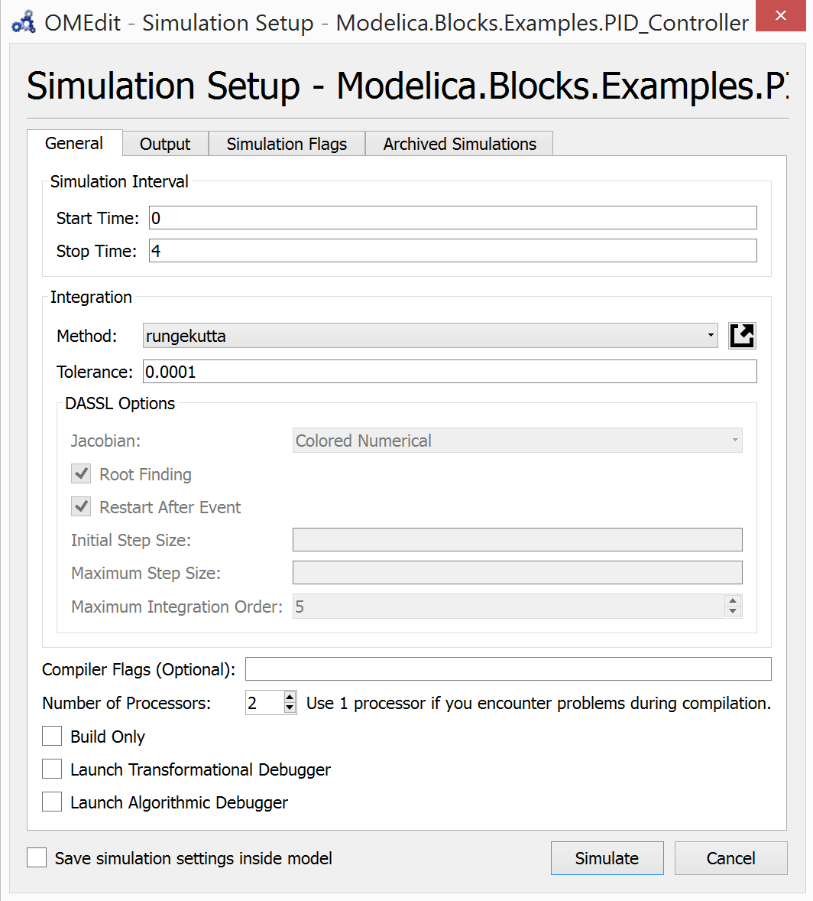
Check of OpenModelica – Step 3
Simulation settings are accessed on the toolbar:
Adjust the settings to match the followings :
Click on Simulate to launch the simulation

Slide 11
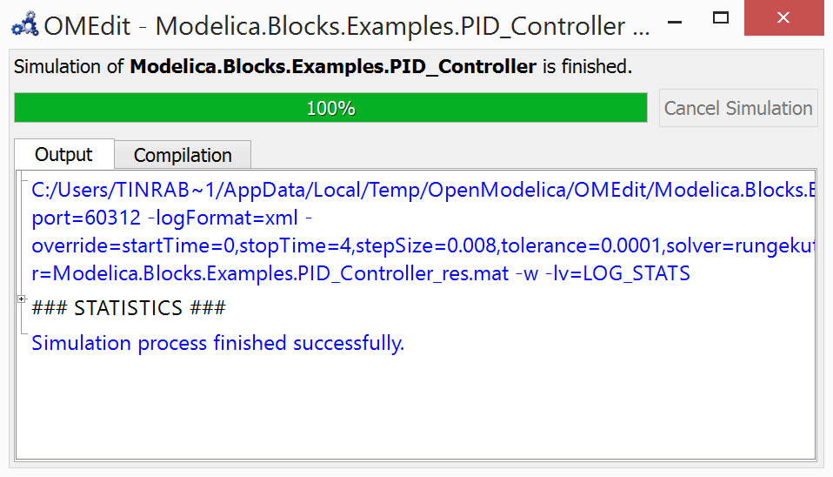
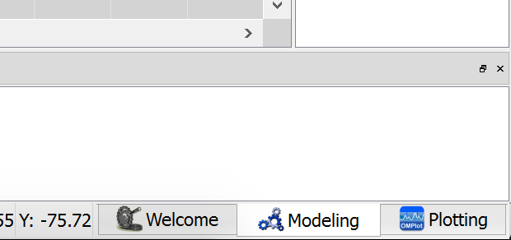
Check of OpenModelica – Step 4a
Once the simulation is completed (100 %):
Access the plotting facility by clicking on the Plotting tab in the lower right corner of the screen

Slide 12
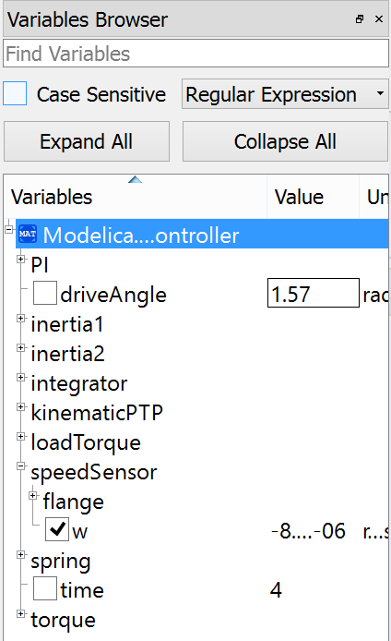
Check of OpenModelica – Step 4b
In the plotting facility, browse the variable to find the rotational speed w

Slide 13
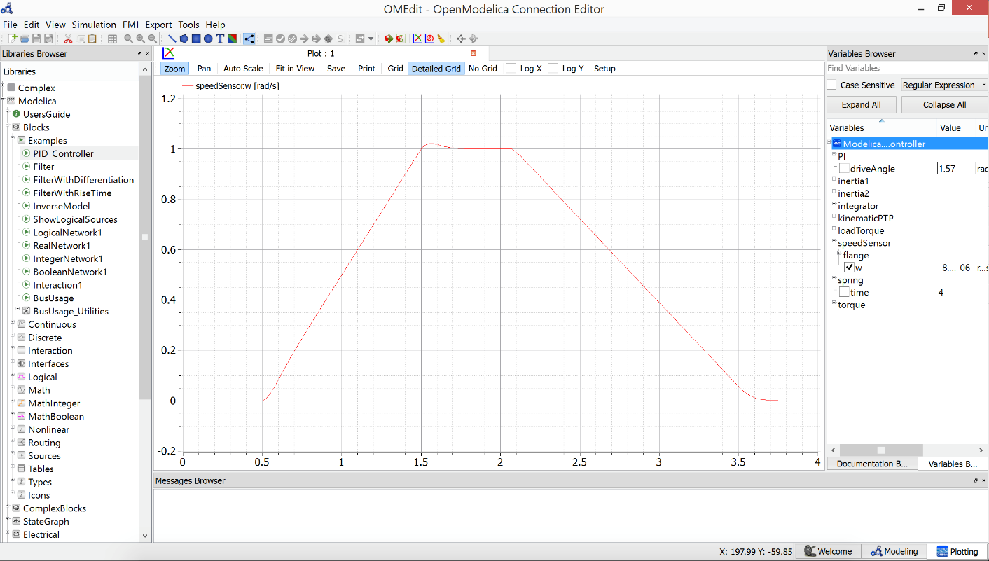
Check of OpenModelica – Final Result
If your screen looks like this, you’re ready to go!

Slide 14
Part 2
Setting up OpenIPSL

Slide 15
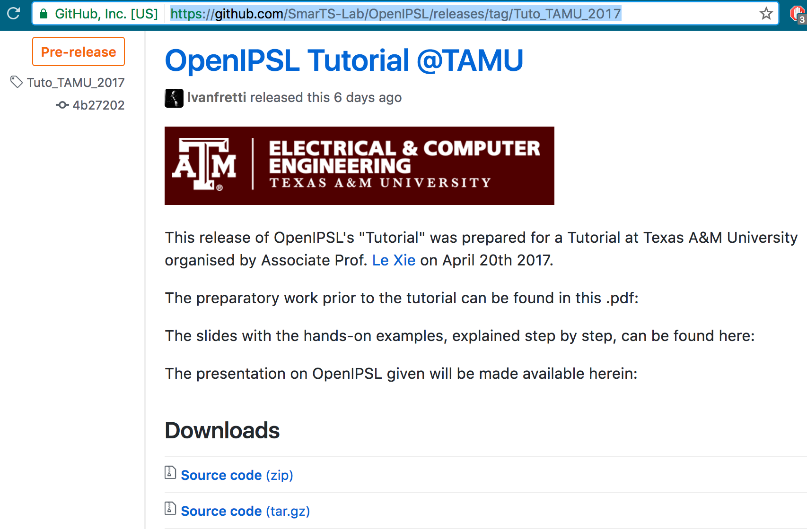
Download the OpenIPSL!
Go to our Github repo:
https://github.com/SmarTS-Lab/OpenIPSL/releases/tag/Tuto_TAMU_2017
Note: A dedicated package will be prepared for the tutorial and uploaded soon.
Please download (again!) the package on the day of the tutorial so that you have the most up to date files.
The dedicated package will also be available on a USB stick that we can circulate on the day of the tutorial.
Click Here!

Slide 16
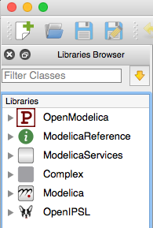
Load the OpenIPSL to OMEdit
External libraries, e.g. OpenIPSL, must be loaded in OMEdit to be used:
Unzip the package downloaded at the previous step
Open OpenModelica Connection Editor (OMEdit)
Go to File/Load Library
Browse to the location of the unzipped folder
Choose the /OpenIPSL folder
The icon with the OpenIPSL puppy should appear
Alternatively:
Drag & drop the package.mo file to the Library Browser in OMEdit.

Slide 17
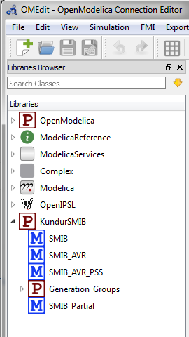
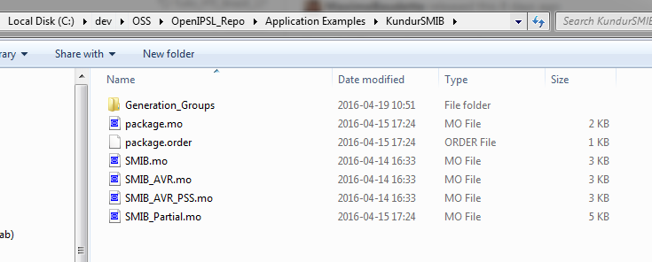
Load an Application Example to OMEdit
Once the OpenIPSL is loaded (see previous slide) in OMEdit, you can load an “Application Example”:
Go to Open Model/Library File(s)
Browse to the location of the unzipped folder
Go to the /Application Examples/KundurSMIB folder, and select package.mo
Alternative:
Drag & drop the package.mo file to the Library Browser in OMEdit.

Slide 18
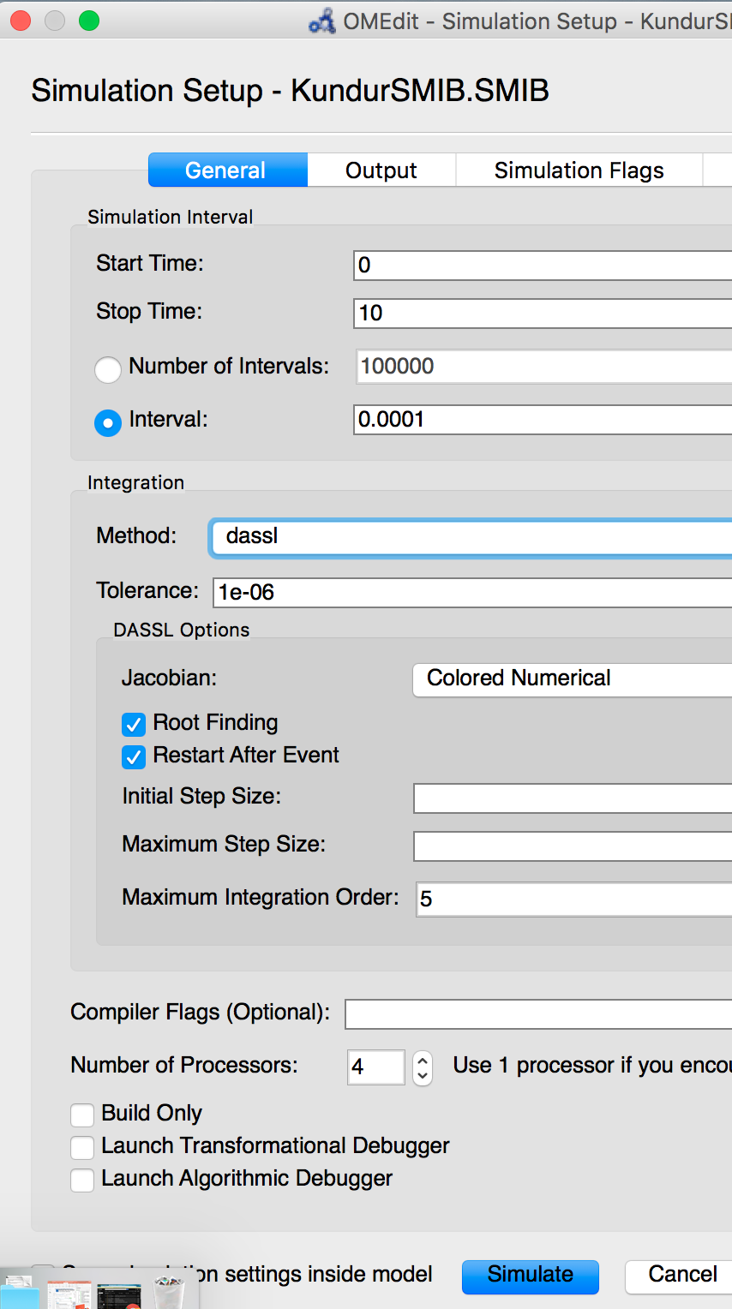
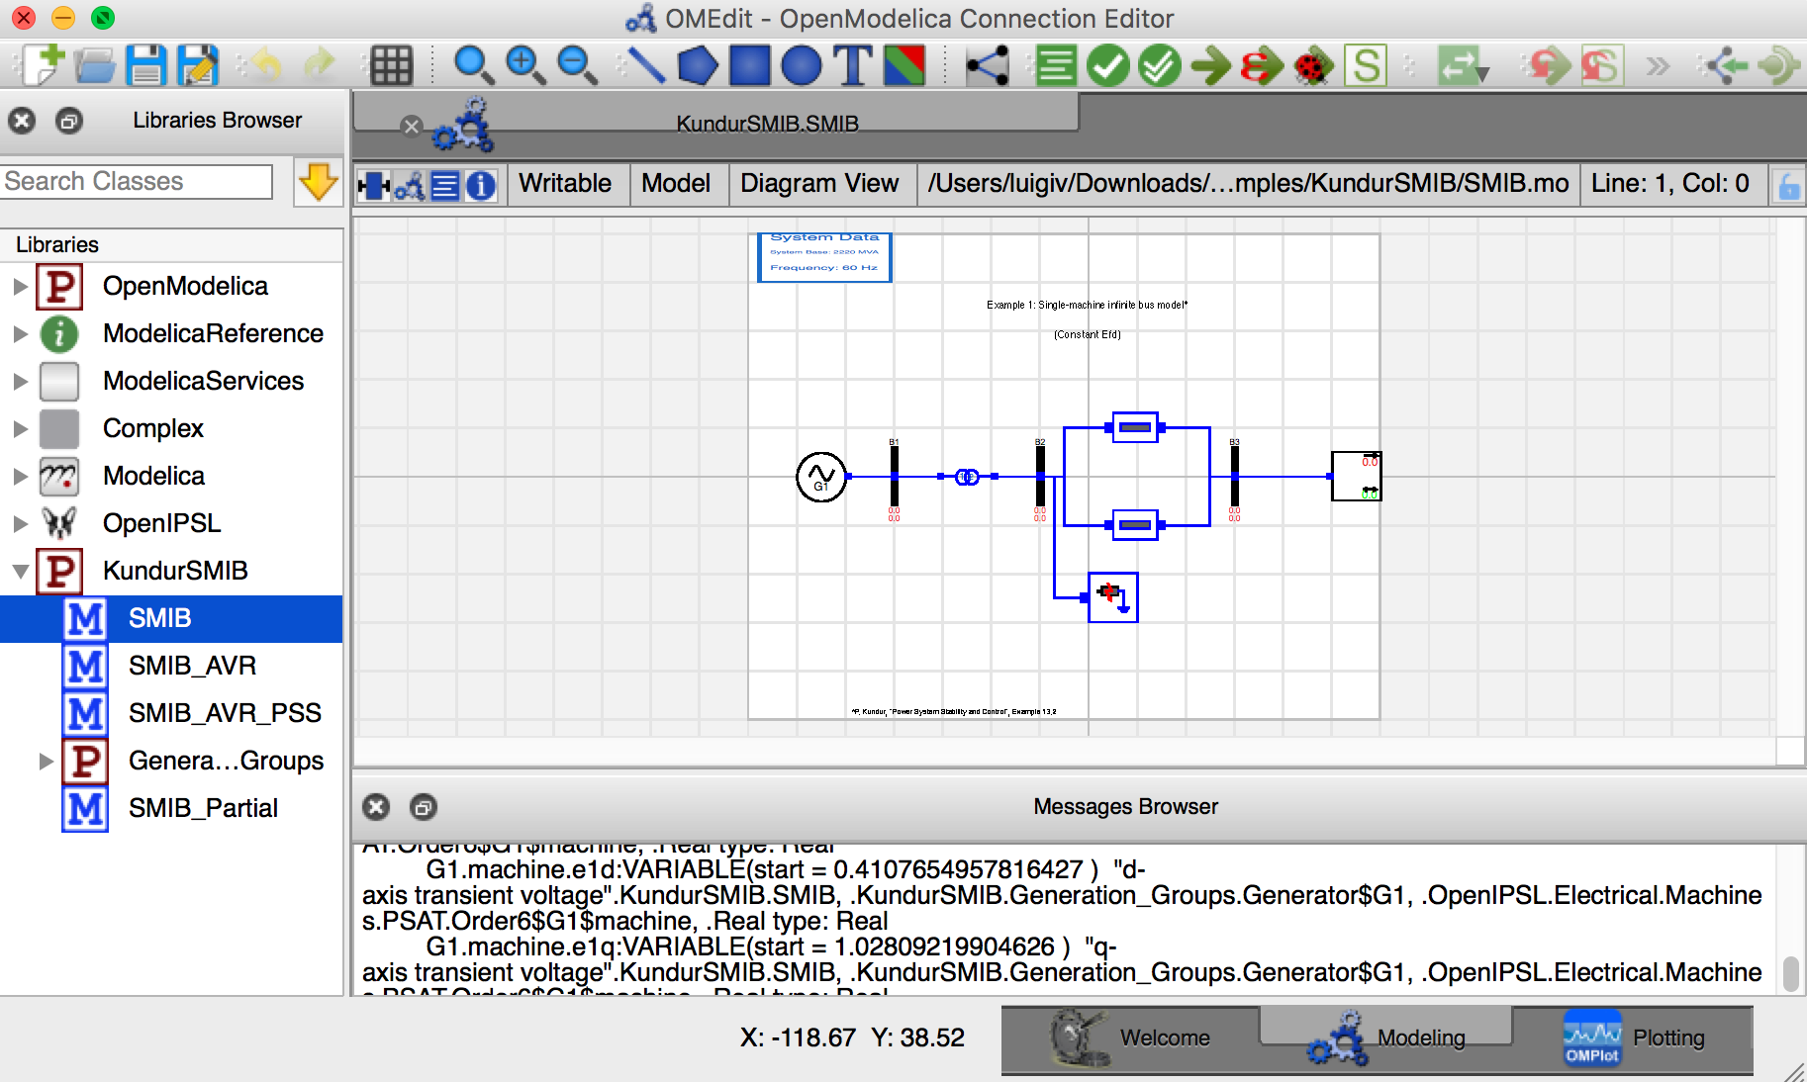
Check that it simulates
Click on “SMIB”, “Simulation Setup” and “Simulate”
Click Here!
Click Here!

Slide 19
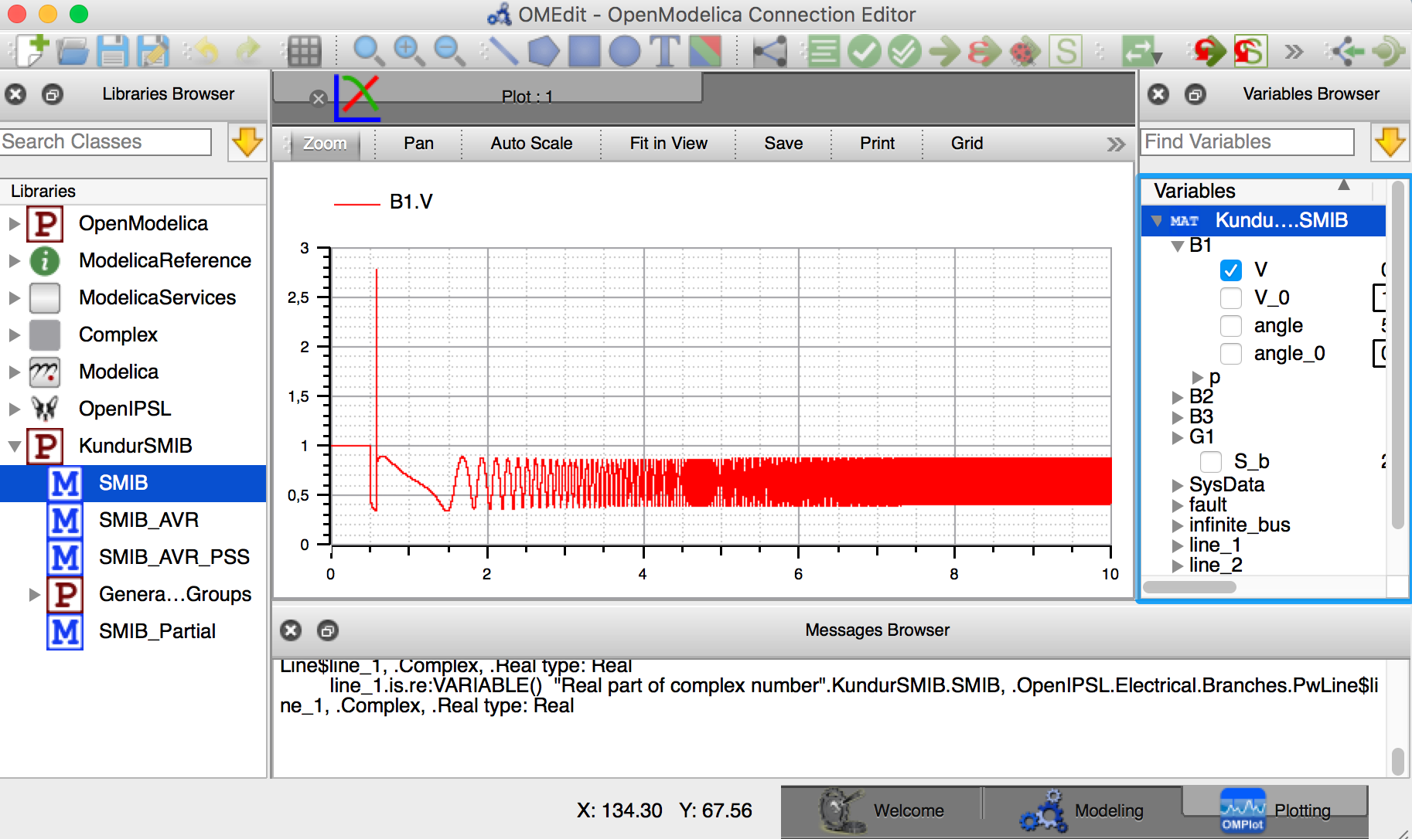
Plot the results
Click on “Plotting”, scroll to “B1” and select “V”

Slide 20
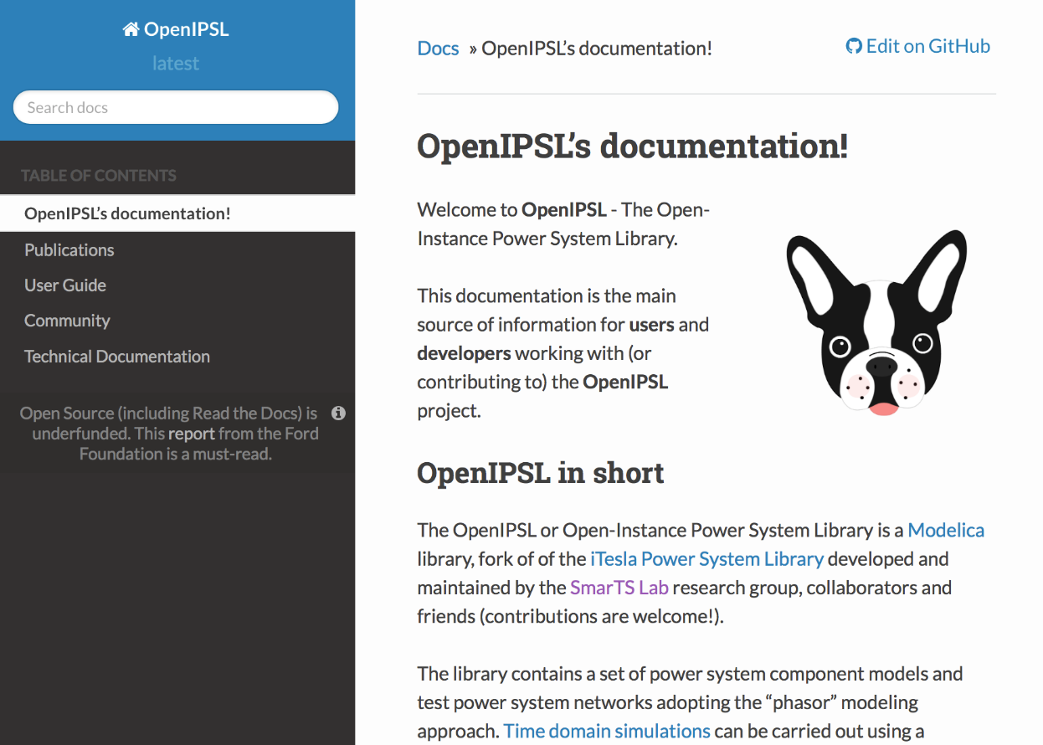
Finally, take a look a our repository and documentation!
Repository: https://github.com/SmarTS-Lab/OpenIPSL
Go to: http://openipsl.readthedocs.io/en/latest/index.html

Slide 21
You are ready! See you for the workshop/tutorial/seminar!

